Slide 1
Side Project
紀政輝

Slide 2
Git Hub repository
Link :https://github.com/Hewitt-Chi

Slide 3
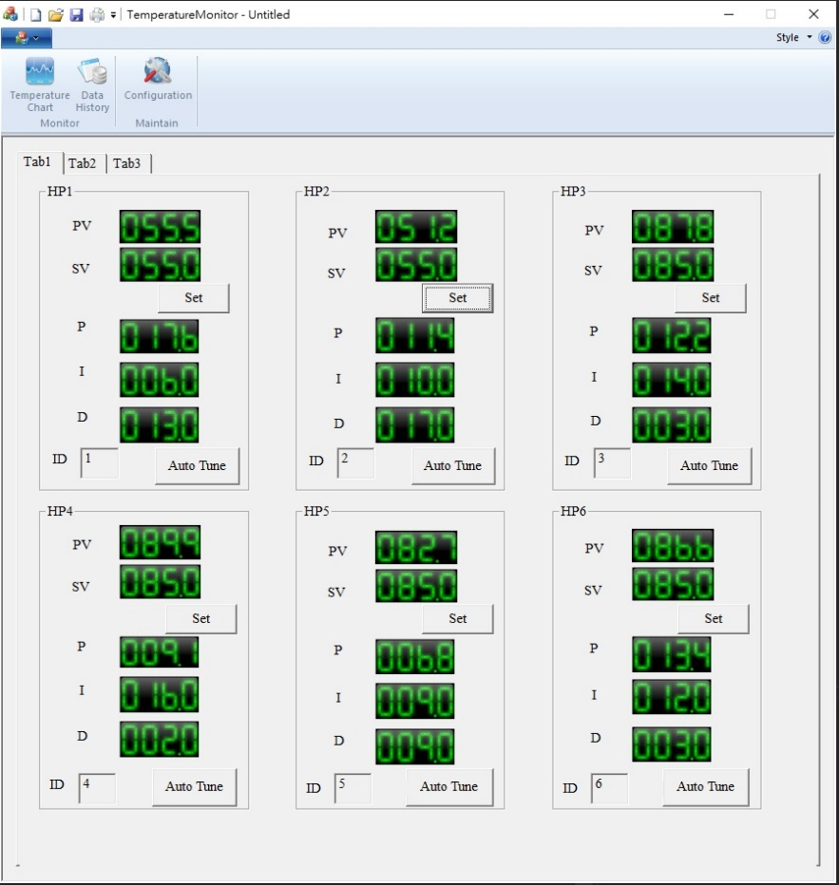
Temperature Monitor
Use MFC to develop a tool program to connect with PLC and monitor the temperature of the temperature control module in real time
Development Framework : MFC
Development environment :WIN10
Execution environment:
WIN10、WIN7、WIN XP

Slide 4
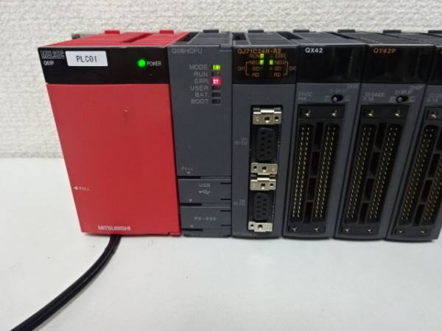
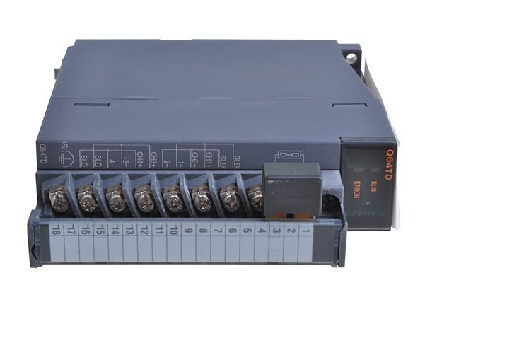
PLC CPU and Temperature control module

Slide 5
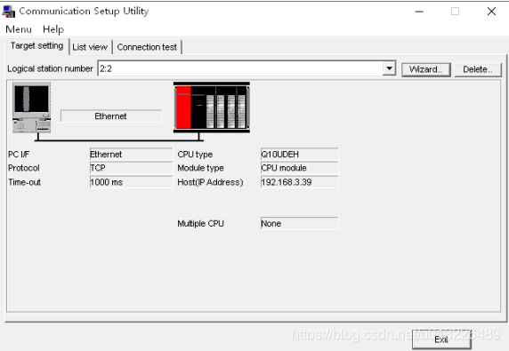
Connect to Mitsubishi PLC via mx component

Slide 6
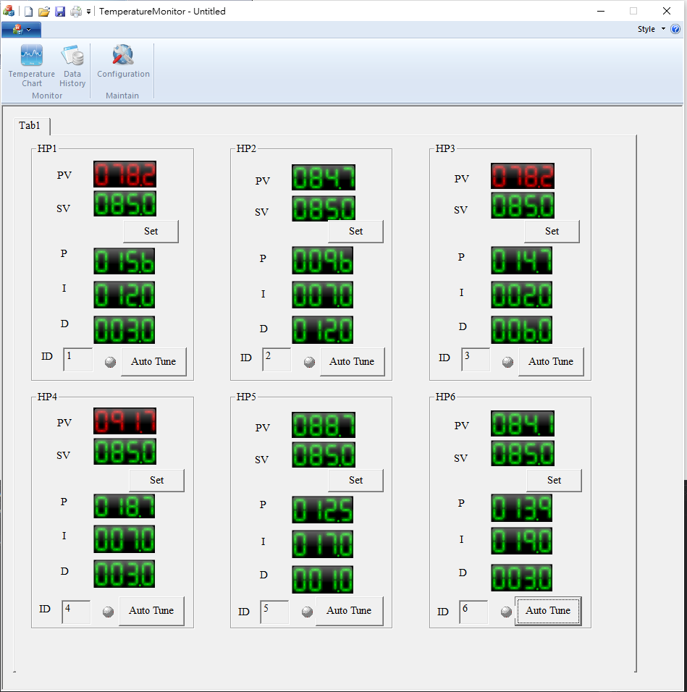
Main Screen
Tool Bar :
Temperature Chart
Data History
Configuration
Model Current Temperature
Current Temp > SV + Alarm Range or < SV – Alarm Range Display Red color
Temperature Setting Target Value
P、I、D Value
Temperature set button
P、I、D auto tune button

Slide 7
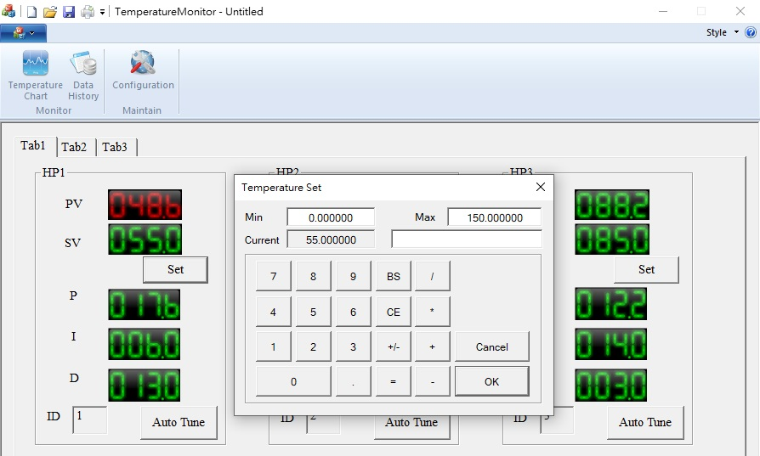
Temperature Setting Function
3. Max :Temperature Setting Value Upper Limit Min : Temperature Setting Value Lower Limit
Current : Current Temperature
1.Click Temperature button
2.Input Temperature setting Screen

Slide 8
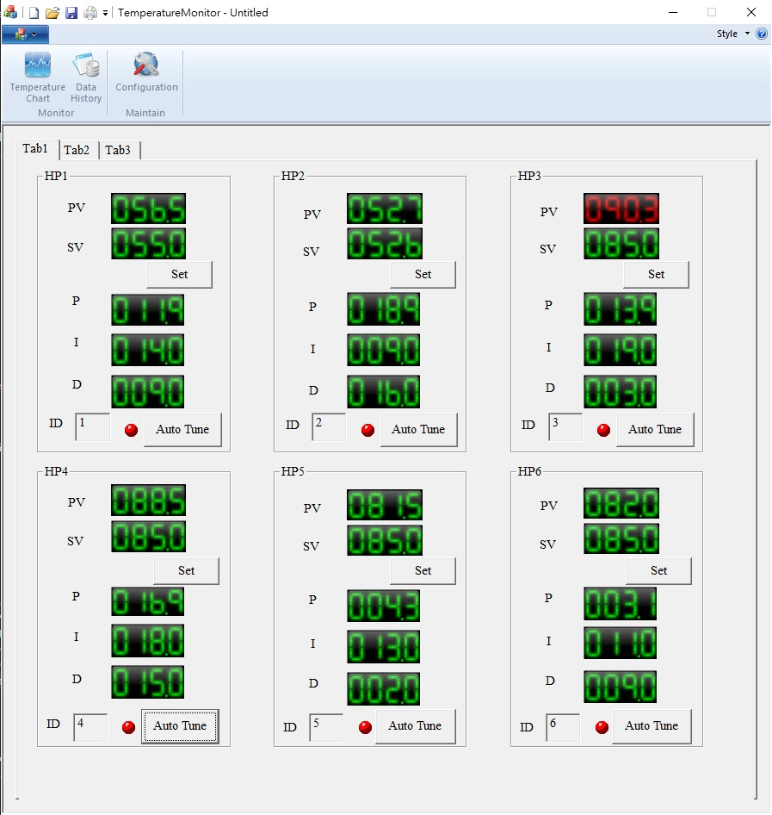
Auto Tune Function
Auto Tune Status
Red : Auto Tunning
Gray : Not Auto Tunning
. Click Auto Tune Button
Display P I D value after Auto Tune finish

Slide 9
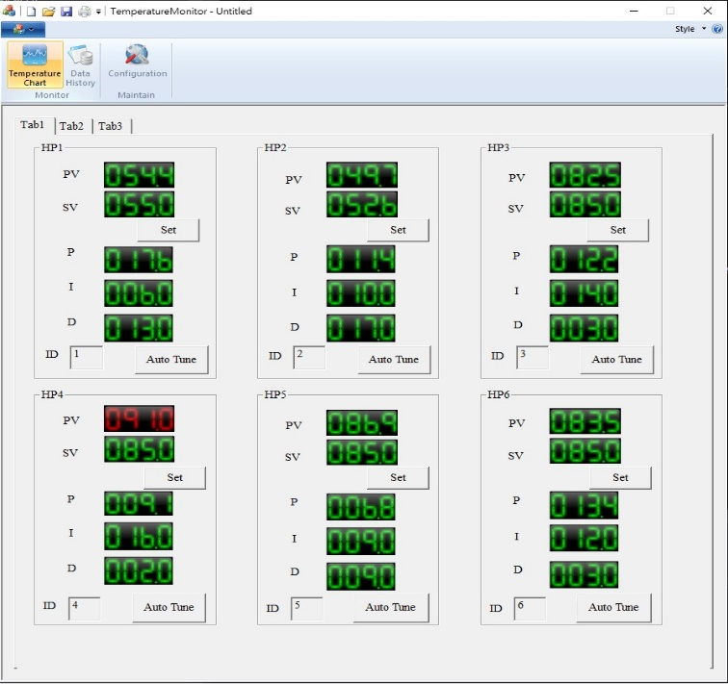
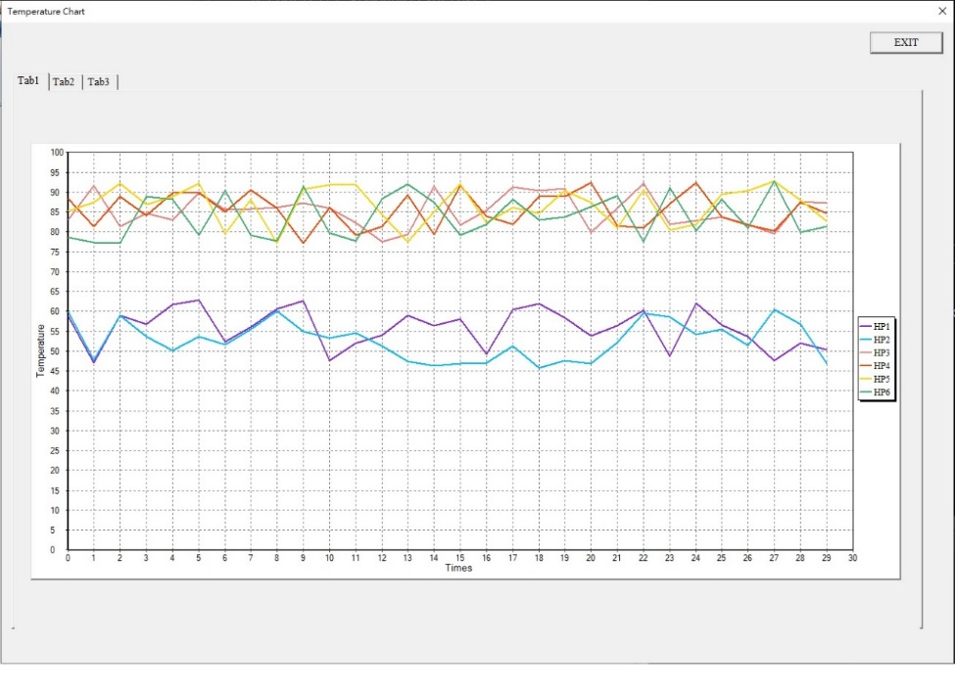
Temperature Chart
. Click Temperature Chart
Display Current Temperature Chart

Slide 10
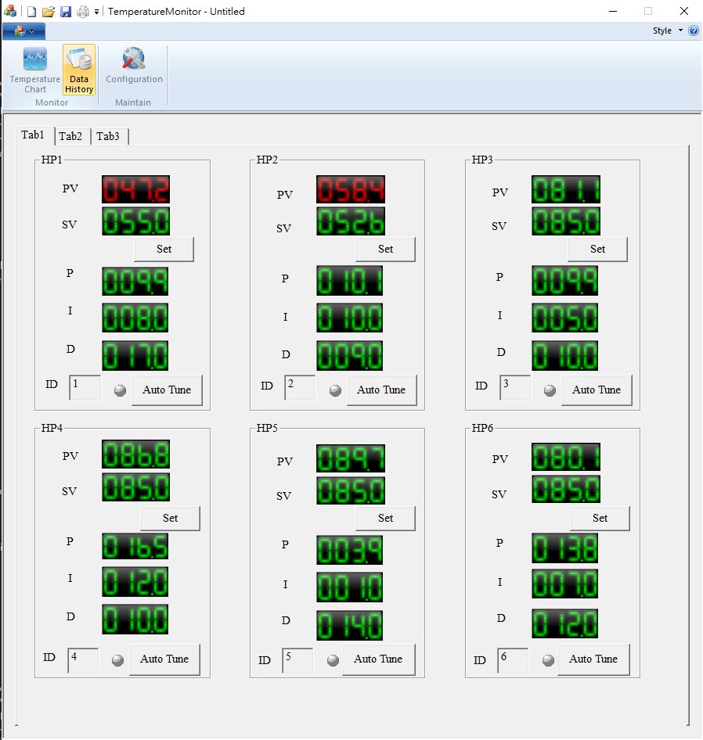
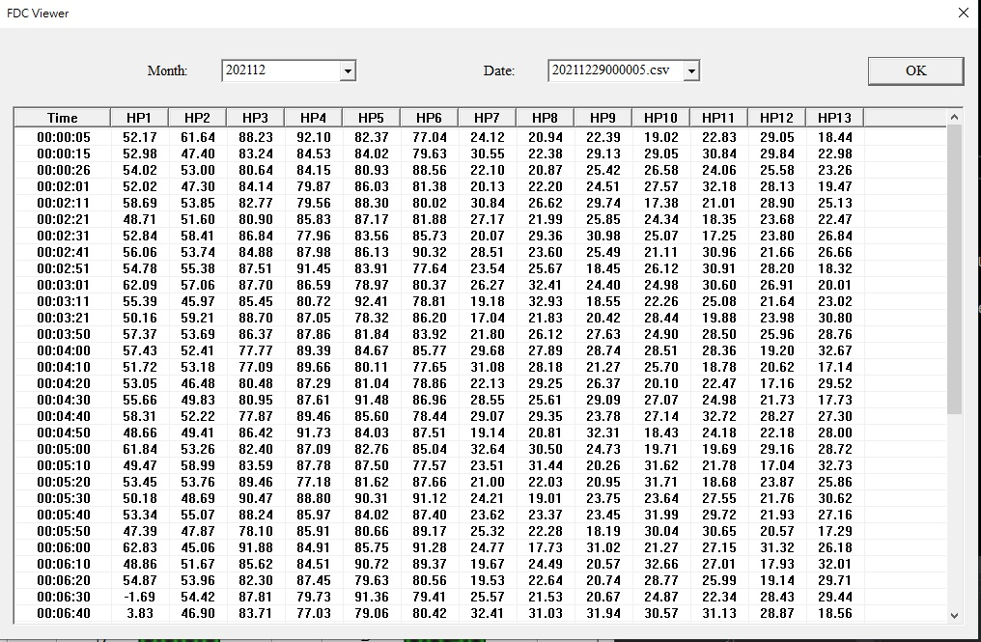
Temperature Data History
content
Display Log history
Click Data History
Select Month
Select Log File to view context

Slide 11
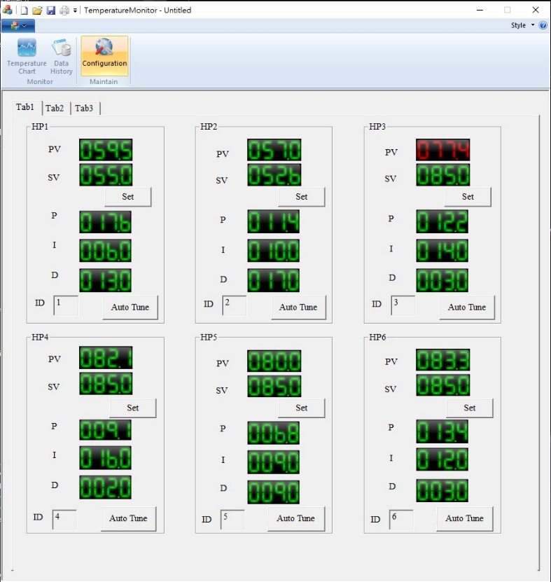
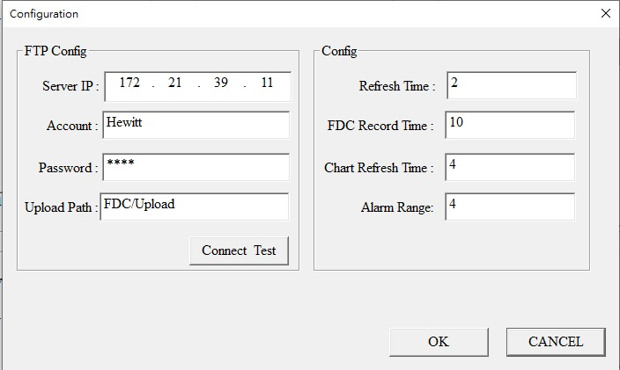
Configuration Screen
Click Configuration button
Upload FDC Log via FTP
Refresh Time : Current Temperature refresh timer.
FDC Record Time : Temperature Log Record Timer.
Chart Refresh Time : Chart Refresh Timer.
Alarm Range : Temperature over range .

Slide 12
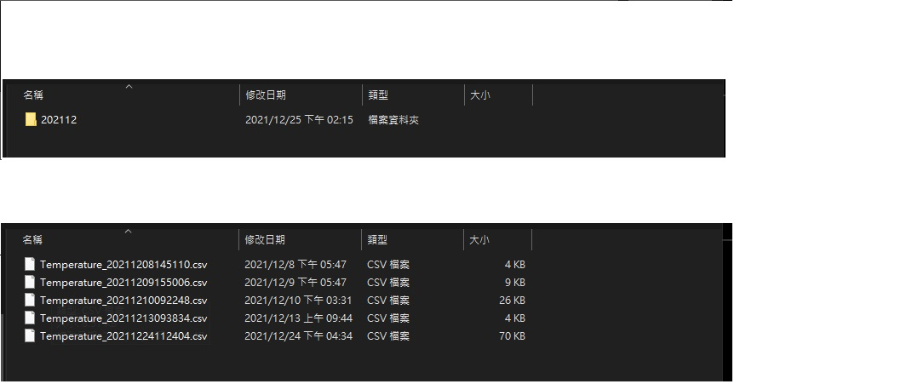
Generate Temperature Log
Generate folders by year and month
Generate log file with csv as file extension

Slide 13
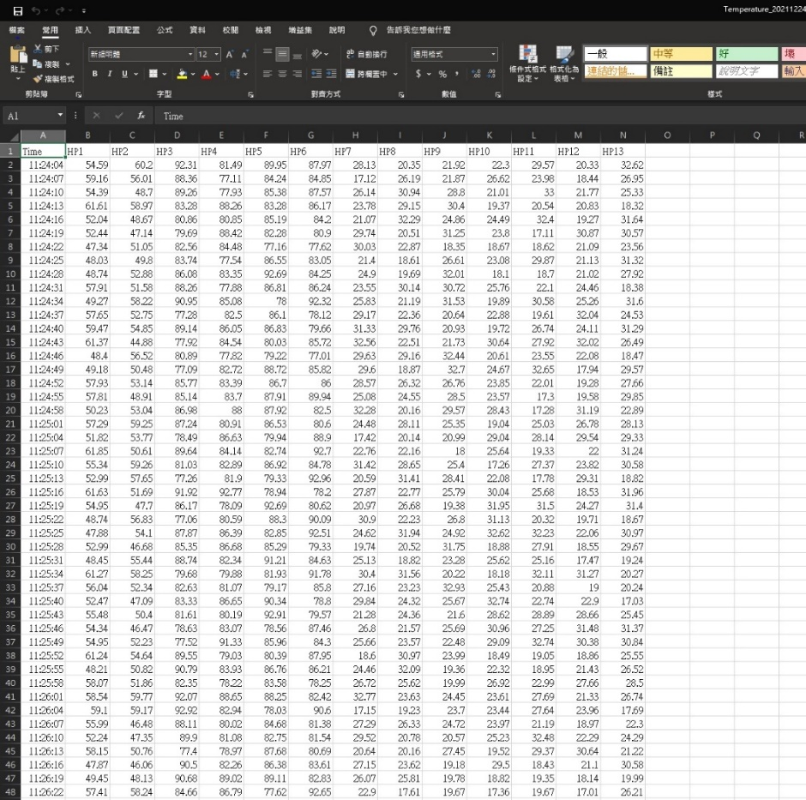
Can use excel open csv log file

Slide 14
XML轉檔程式

Slide 15
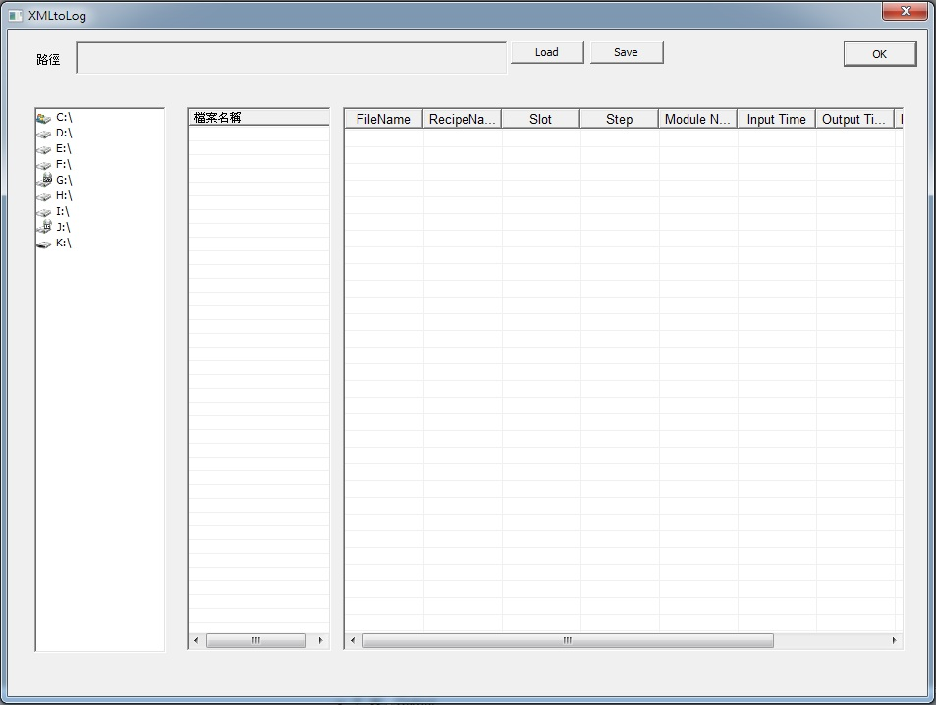
XML轉檔程式

Slide 16
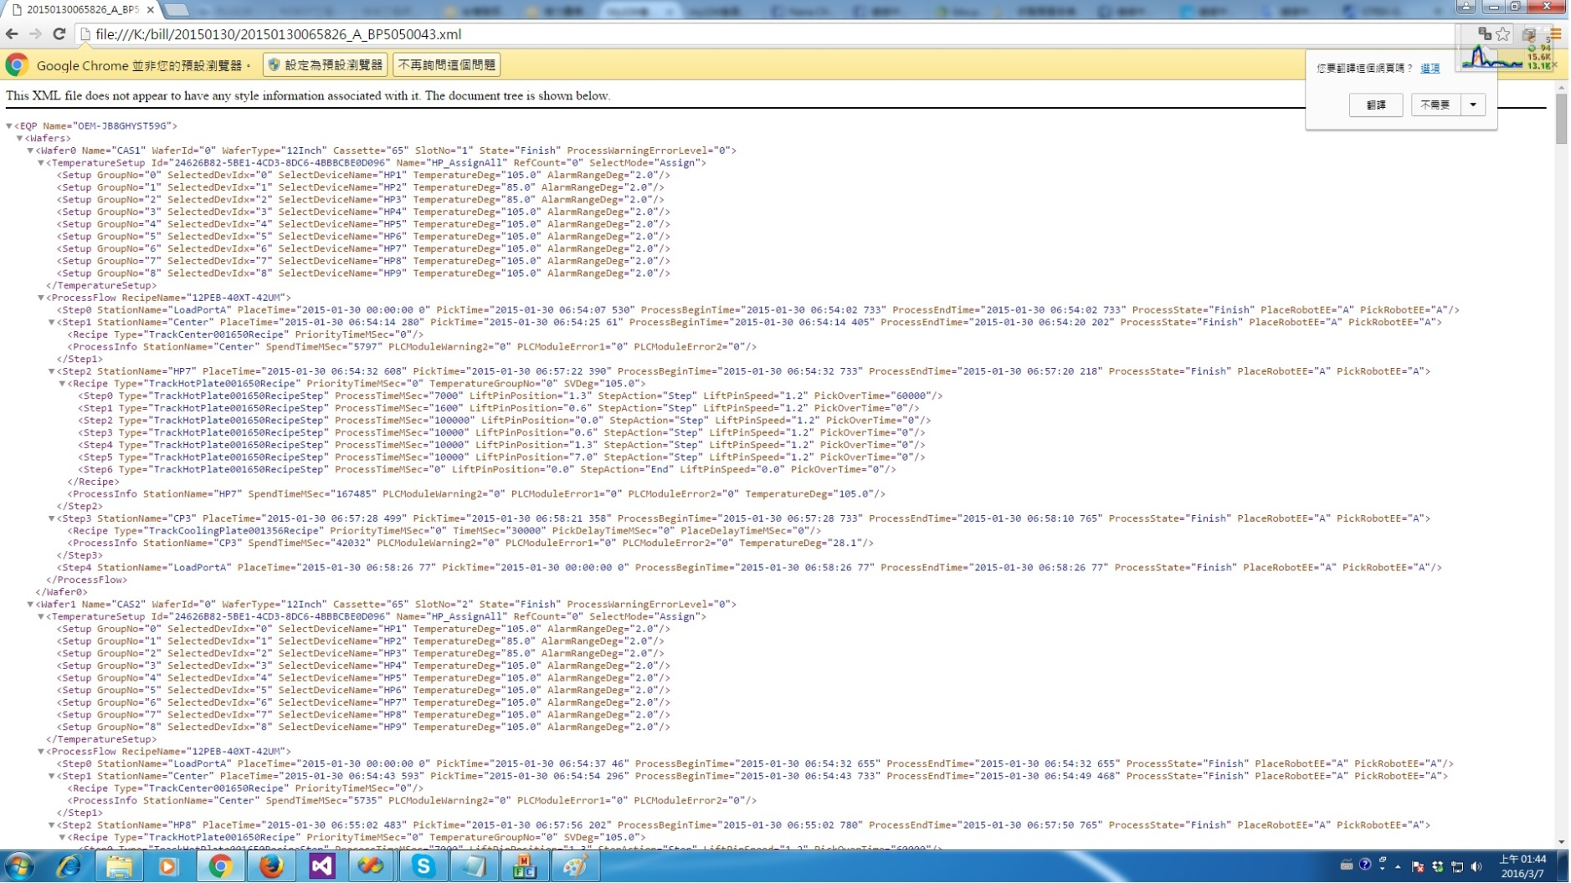
XML Log

Slide 17
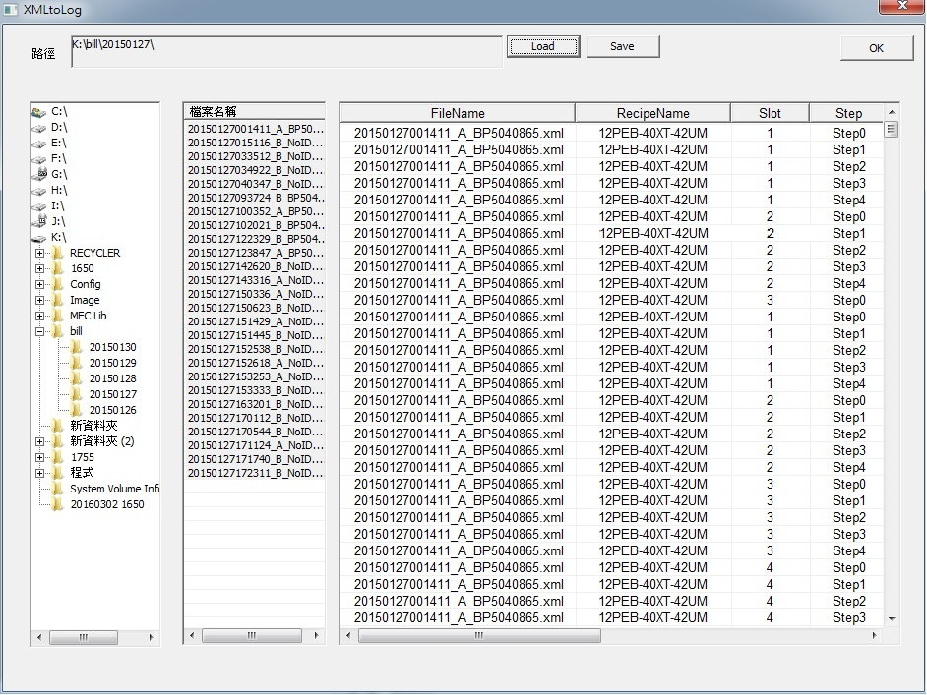
可預覽Xml Log中的元素

Slide 18
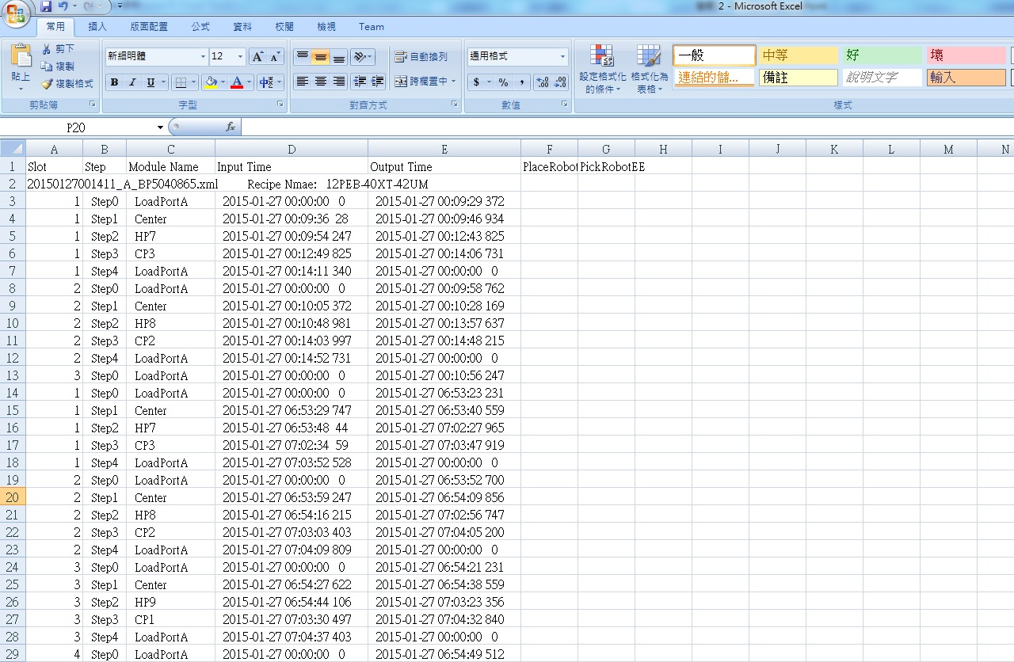
並輸出成CSV檔

